Slide 1
HIVE PROJECT Associate Management System

Slide 2
Roles And Responsibilities:
Developer : Anand
Database Admin : Kavya
Quality Manager : Akhil
Data Analyst : Venkat

Slide 3
TOOLS:
HIVE
SQ
Hadoop
CDH5
GitHub
GitHub Link: https://github.com/kanand2306/Associate-Management-System.git

Slide 4
ABSTRACT:
The main aim of this project is to manage the database of an educational institute which provides the courses in various domain.
It consists of associate details like how many Trainee's were attended for demo, joined, enrolled for the courses like Bigdata, IOT, machine learning, artificial Intelligence etc.
Whenever the administrator needs the information about the trainees , they should be able to fetch the required data.

Slide 5
HIVE:
Hive is the Data Warehouse Infrastructure tool to process structured data in Hadoop.
Hive is the product of Facebook
Hive is present on the top of the Hadoop , it means it is installed Ina single machine.
It stores Schema in a database and processed data into HDFS.
It provides SQL type language for querying called called HIVEQL or HQL.

Slide 6
ORC METHOD:
ORC - Optimized Row Columnar.
It is a file format provides a highly efficient way to store Hive data.
Using ORC files improve performance when Hive is reading, writing and processing data.
ORC stores collection of rows in one file and within the collection the row data is stored in a columnar format.

Slide 7
ACID PROPERTIES:
Hive supports all ACID properties which enable us to use transactions, create transactional tables, and run queries like Insert, Update and Delete on tables.
TBLPROPERTIES(‘transactional’ = ‘true’) at the time of creating Managed table
Managed Table should use ORC Format.

Slide 8
set hive.support.concurrency = true;
set hive.enforce.bucketing = true;
set hive.exec.dynamic.partition.mode = nonstrict;
set hive.txn.manager = org.apache.hadoop.hive.ql.lockmgr.DbTxnManager;
set hive.compactor.initiator.on = true;

Slide 9
CRUD OPERATION:
In order to perform CREATE, READ, UPDATE, DELETE we have to ensure while creating the table with the following conditions.
File format should be in ORC file format with TBLPROPERTIES(‘transactional’=‘true’)
Table should be CLUSTERED BY with some Buckets.

Slide 10
TABLE DETAILS:
Here we are maintaining the database such as :
Master Table
Demo Table
Enroll Table
Payment Table
Here we are maintaining a master table which consists of trainees details like ID, name, Date of birth, gender, address, email, mobile number, course, fee, discount, status1 and status2.

Slide 11
Demo table contains the information like Trainee's who’s demo has been completed, demo has scheduled either in weekend days or week days, who’s demo has not been completed.
Enroll table contains the information like joining details , batch day and time.
Payment table consists of information like amount paid, number of installments and due date.

Slide 12
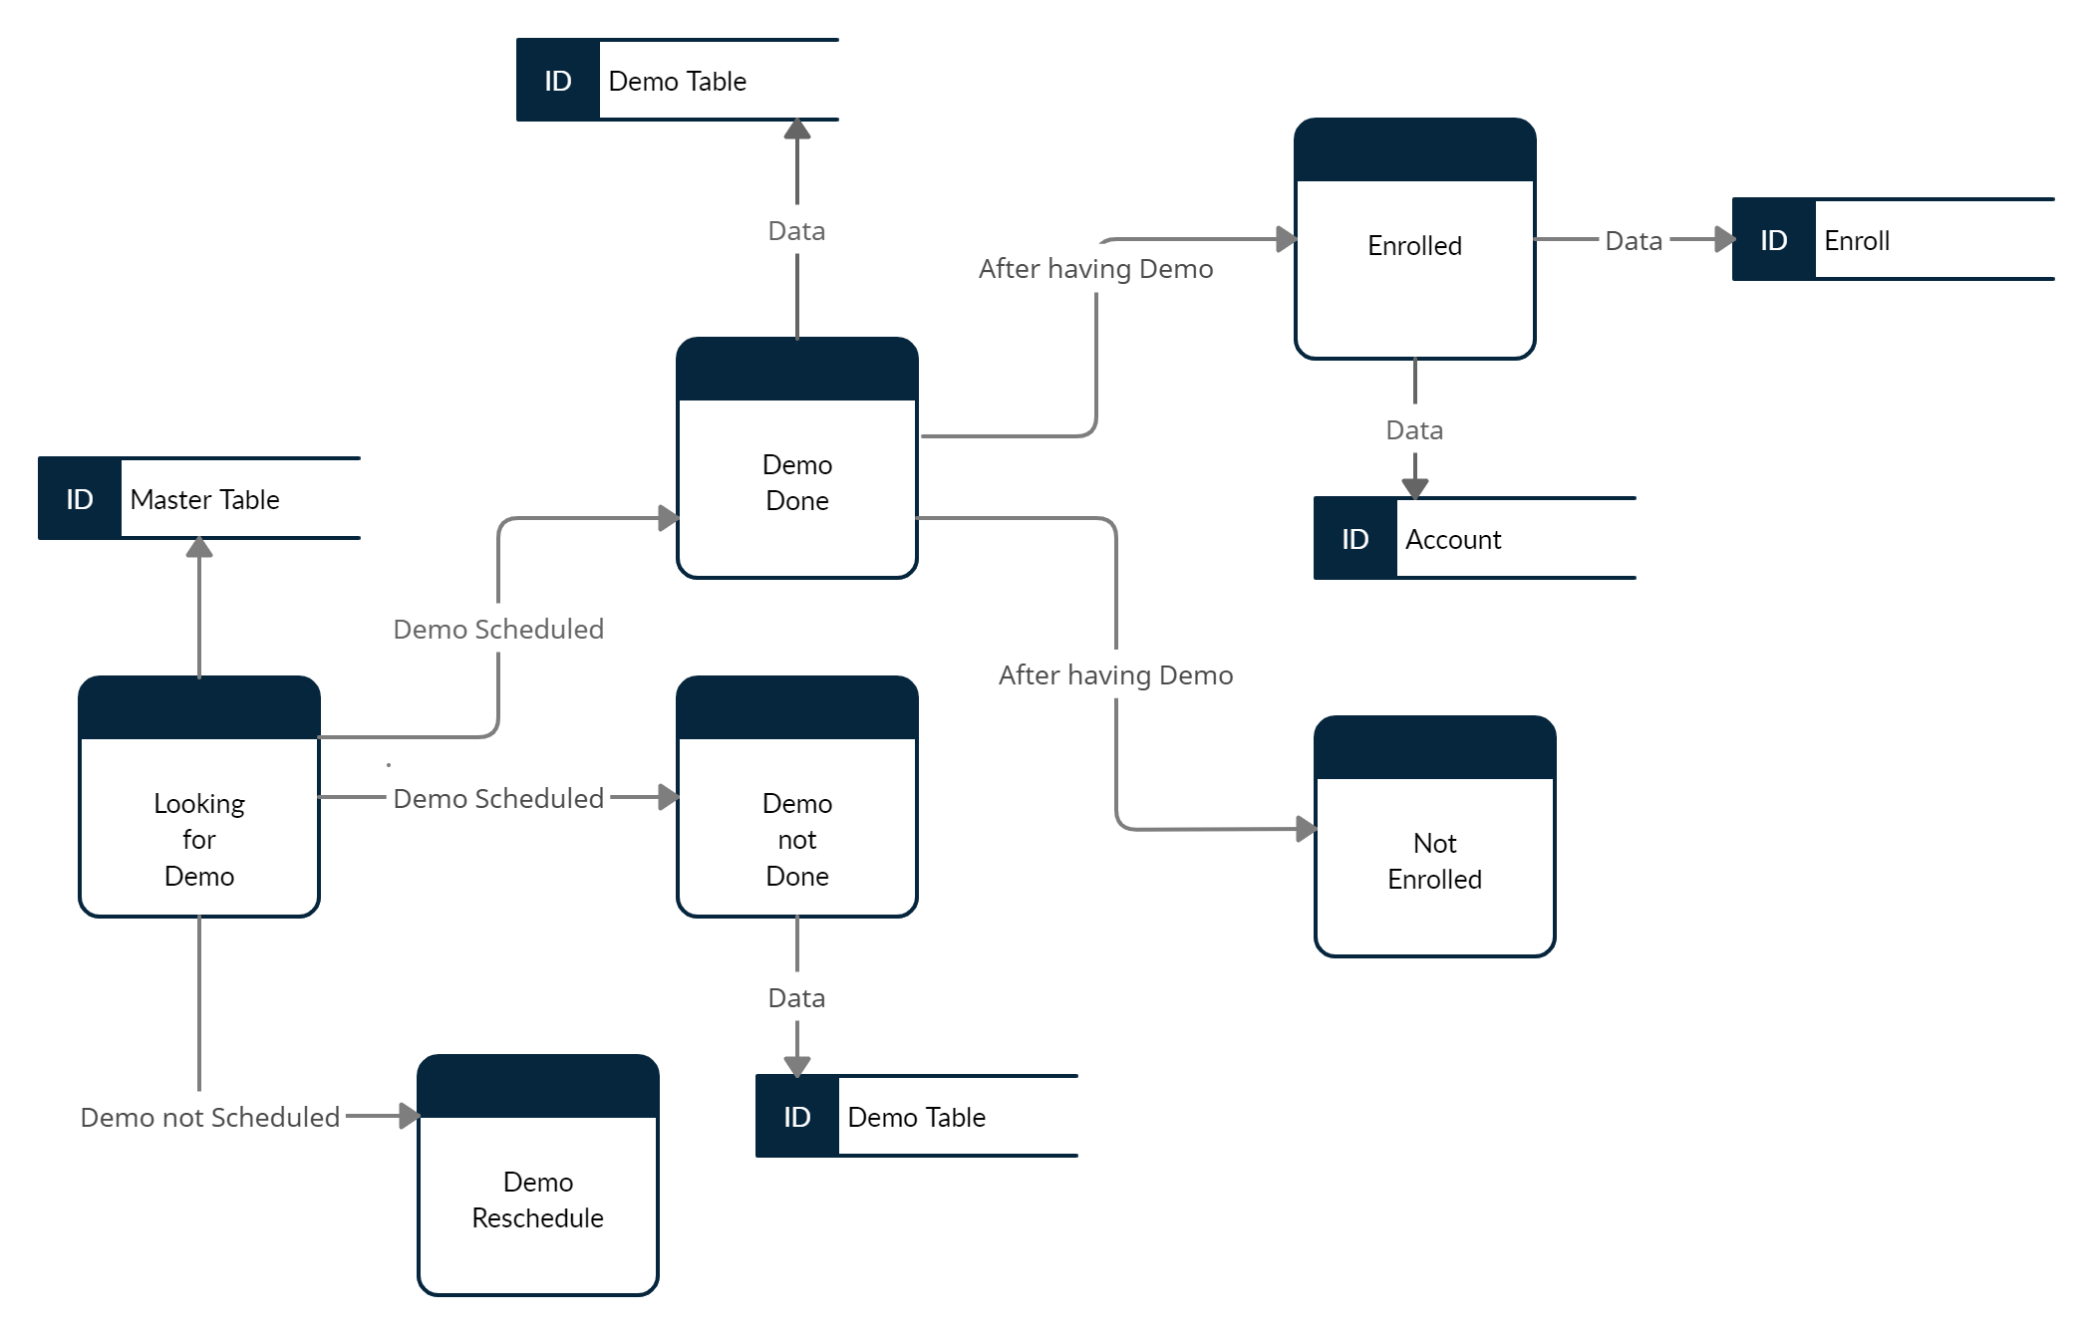

Slide 13
Master TABLE:
Column | Datatype | Description of column
id | INT | Unique number of Trainee's
Name | STRING | Name of Trainee's
Dob | STRING | Date of birth of Trainee's
Gender | STRING | Female, male
Address | STRING | Address of Trainee's
Email | STRING | Email of Trainee's
Course | STRING | Courses such as bigdata ,machine learning, AI, IOT

Slide 14
Master TABLE:
Column | Datatype | Description of Column
Fee | INT | Course fee
Discount | INT | Concession in total fee
Status1 | STRING | Demo Scheduled, Enroll, Demo not Schedule,
Status2 | STRING | Weekday, Weekend (day, time)

Slide 15
Create a table for storing the data for master table:
create table m(id int, name string, dob string, gender string, email string, contact bigint, course string, fee double, discount int, status1 string, status2 string) row format delimited fields terminated by ',' lines terminated by '\n' stored as textfile;
Load the data:
load data local inpath ”/home/kavyareddy0124/master.txt '' into table m;
Create table Master:
create table master(id int, name string, dob string, gender string, email string, contact bigint, course string, fee double, discount int, status1 string, status2 string) stored as orc tblproperties('transactional'='true');
Insert data into master:
insert into master select * from m;

Slide 16
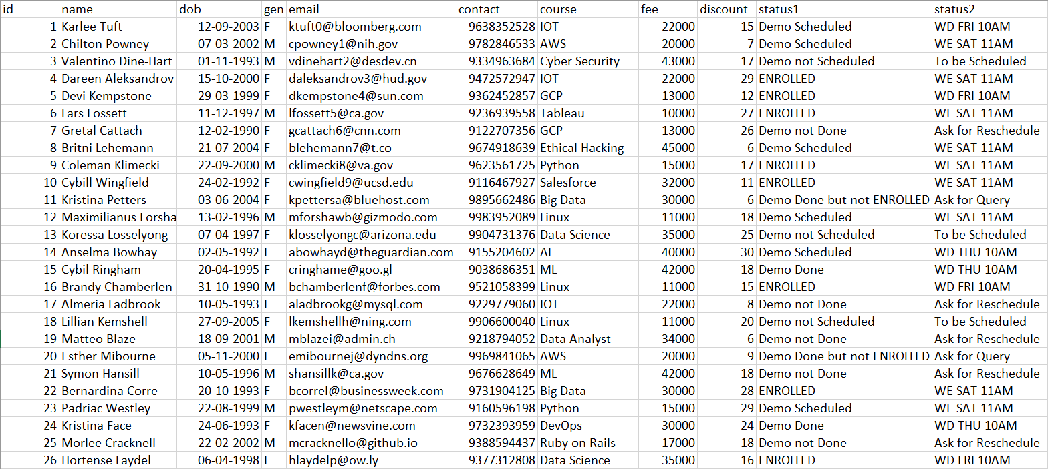
MASTER TABLE

Slide 17
Demo Table:
Column | Datatype | Description of Column
id | INT | Trainee's unique number
Name | STRING | Trainee's name
Course | STRING | Course such as bigdata, IOT, GCP, Tableau
Demo status | STRING | Shows the status of demo
Demo timing | STRING | It shows the day and timing of demo

Slide 18
Create table demo:
create table demo(id int, name string, course string, demo_status string, demo_timing string) stored as orc tblproperties('transactional'='true');
Insert the value in demo table using master table:
insert into demo select id, name, course, status1, status2 from master where status1 = 'Demo Scheduled' or status1 = 'Demo Done';

Slide 19
Enroll Table:
column | Datatype | Description of column
Id | INT | Trainee's unique number
Name | STRING | Trainee's Name
Course | STRING | Course such as IOT, Bigdata, Tableau
Batch Status | STRING | Shows the status after Enrollment
Batch Timing | STRING | It shows the day and timing of the batch for enrolled students

Slide 20
Create table enroll:
create table enroll(id int, name string, course string, enroll_status string, enroll_status string batch_timing string) stored as orc tblproperties('transactional'='true');
Insert the value in enroll table using master table:
insert into enroll select id, name, course, status1, status2 from master where status1 = 'ENROLLED';

Slide 21
ACCOUNT TABLE:
column | Datatype | Description of Column
id | INT | Trainee's unique number
Name | STRING | Trainee's Name
email | STRING | Trainee's Email
Contact | INT | Trainee's contact number
course | STRING | Course such as IOT, AI, Bigdata
Total | DOUBLE | Total amount of course
Paid | INT | Paid amount
Installements | INT | No.of Installements
Amount per Installement | DOUBLE | How much money Trainee's need to pay per installment
Last date of payment | STRING | The last date on which the Trainee's has done the payment
Due date | STRING | The due date by which the total fee should be submitted

Slide 22
Create an Account table for storing data of account table:
create table a(id int, name string, email string, contact bigint, course string, total double, paid double, installments int, amount_per_installment double, last_payment_date string, due_date string) row format delimited fields terminated by ',' lines terminated by '\n' stored as textfile;
Load the data:
Load data local inpath ‘'file:///home/cloudera/Desktop/account'’ into table a;
Create an Account table:
create table account(id int, name string, email string, contact bigint, course string, total double, paid double, installments int, amount_per_installment double, last_payment_date string, due_date string) stored as orc tblproperties('transactional'='true');
Insert data into account:
Insert into account select * from a;

Slide 23
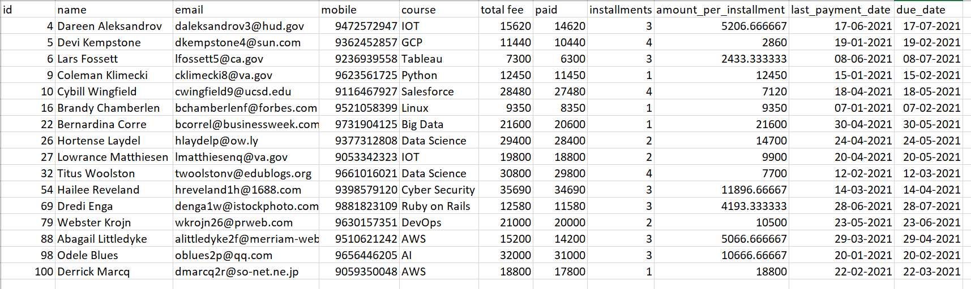
ACCOUNT TABLE

Slide 24
Commands:
1. Number of Distinct courses.
-> select course, count(*) from master group by course;
2. Number of courses enrolled by each student.
-> select name, course, count(*) from master group by name, course;
3. List of Students whose demo has been scheduled.
-> select * from master where status1="Demo Scheduled";
4. List of students whose demo has not been scheduled.
-> select * from master where status1="Demo Done";
5. List of students who are done with their demo.
-> select * from master where status1="Demo Not Done";
6. List of students who haven’t attended demo.
-> select * from master where status1="Demo Not Scheduled";

Slide 25
Commands:
7. List of students who have enrolled in any of the course.
-> select * from master where status1="Enrolled";
8. List of students who attended demo but not enrolled.
-> select * from master where status1="Demo Done but not Enrolled";
9. List of students whose demo was scheduled on Weekday’s.
-> select * from master where status1="Demo Scheduled" and status2 like "WD%";
10. List of students whose demo was scheduled on Weekend’s.
-> select * from master where status1="Demo Scheduled" and status2 like "WE%";
11. Number of male and female associates are there.
-> select gender, count(*) from master group by gender;
12. Maximum discount offered in respective course.
-> select course, max(discount) as max_discount from master group by course;
13. Minimum discount offered in respective course.
-> select course, min(discount) as min_discount from master group by course;

Slide 26
Commands:
14. Total fee of all students
-> select sum(total) from account;
15. Total paid fees of all students
-> select sum(paid) from account;
16. Fee details of enrolled students
->select master.id, master.name, master.course, master.fee, master.discount, account.total, account.paid from master, account where master.id=account.id;

Slide 27
THANK YOU

